Slide 1
COLOR DETECTION USING OPENCV AND PANDAS
PRESENTED BY:
ARUNA K
PREETHI B
BATCH NUMBER : A2
GUIDE NAME : Dr. K.SANGEETHA

Slide 2
abstract
We are going to build a python project through which we can automatically get the name of the color by clicking on them. So for this, we will have a data file that contains the color name and its values. we will calculate the distance from each color and find the shortest one.

Slide 3
What is Colour Detection?
Colour detection is the process of detecting the name of any color.
For humans this is an extremely easy task but for computers, it is not straightforward.
Human eyes and brains work together to translate light into color. Light receptors that are present in our eyes transmit the signal to the brain.
Our brain then recognizes the color. Since childhood, we have mapped certain lights with their color names. We will be using the somewhat same strategy to detect color names.

Slide 4
LITERATURE SURVEY
Year of publishing | Author name | Title of the paper | Merits | Demerits
2017 | Dong-Won Jang & Rae-Hong Park | Color Fringe Correction by the Color Difference Prediction Using the Logistic Function | The proposed approach is highly helpful in restoring the original object color in the degraded edge. | Not efficient for region-based color difference prediction.
LINK | https://ieeexplore.ieee.org/document/7886336

Slide 5
Year of publishing | Author name | Title of the paper | Merits | Demerits
2018 | Sahar Sabbaghi Mahmouei , Mohammad Aldeen,William V.Stoecker & Rahil Garnavi | Biologically Inspired QuadTree Color Detection in Dermoscopy Images of Melanoma | The proposed color palette mimics human color interpretation and detected colors and color locations can be immediately applied in the clinic. | Application of the color palette and QuadTree color clustering to larger, publically available datasets is not available.
LINK | https://ieeexplore.ieee.org/document/8368055

Slide 6
Year of publishing | Author name | Title of the paper | Merits | Demerits
2018 | Sudharshan Duth & M. Mary Deepa | Color detection in RGB-modeled images using MAT LAB | This research work introduces a method of using color thresholds to identify two-dimensional images in MATLAB using the RGB Color model to recognize the Color preferred by the user in the picture | The most drawback is with the threshold that solely the intensity values of the picture element are taken under consideration and no relationship between them is taken into Account.
LINK | https://www.researchgate.net/publication/325736179_Color_detection_in_RGB-modeled_images_using_MAT_LAB

Slide 7
Year of publishing | Author name | Title of the paper | Merits | Demerits
2019 | Xiaoyang Liu, Dean Zhao, Weikuan Jia, Wei Ji & Yueping Sun | A Detection Method for Apple Fruits Based on Color and Shape Features | The proposed method combines the color feature and shape feature to detect fruits and can improve the accuracy of fruit detection. | Pixel-wise segmentation is more precision than detection boxes.But , the system just detects fruits by rectangle boxes.
LINK | https://ieeexplore.ieee.org/document/8720218

Slide 8
EXISTING SYSTEM
Color Detection System for Industrial Applications Using Arduino
In the existing system they have gone through with the opencv but while extraction of the colors they got the wrong outputs.
There is no exact color representation of colors with accuracy.

Slide 9
PROPOSED SYSTEM
In the proposed system, we are introducing the CV database and according to it the number of shades that can be identified using 865 color names along with their RGB and hex values.
Whenever the cursor clicks the image, it automatically shows the RGB shades color values.

Slide 10
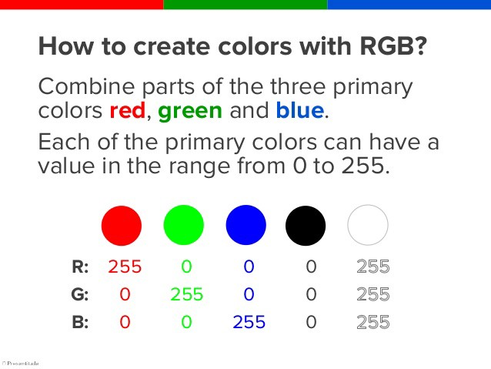
The Dataset
Colors are made up of 3 primary colors; red, green, and blue.
In computers, we define each color value within a range of 0 to 255. There are approximately 16.5 million different ways to represent a color.
In our dataset, we need to map each color’s values with their corresponding names. So ,we will be using a dataset that contains RGB values with their corresponding names. Here we are going to use 865 color names along with their RGB and hex values.

Slide 11
ARCHITECTURE
The image below shows how the complete process of color detection is carried out.
IMAGE
IMAGE PROCESSING
CLICK ON PT. WHOSE IS TO BE CHECKED
OUTPUT

Slide 12
MODULES
Capturing and Storing Image
Image Processing
Color Detection

Slide 13
module 1- Capturing and storing image
In this module, the capturing of image takes place. The image stored in this process is later used for detecting the color.
The program stores the image and resizes it to 800*600 pixels of image the user gives in as input. The reduction of image size and leads to judicial use of the storage provided.

Slide 14
Module 2- Image Processing
In this module, when the program is executed the program opens a window of size 800*600 image pixel are processed an the program loads the image in the window.
In this module, the programs run over & gives the image for further operation.
When all the images are perfectly processed and the program is ready to detect the color.

Slide 15
Module 3-Color Detection
In this module, the programs has completed the Image Processing and is ready to take the input of the user.
The program which is already displaying the window can now be clicked anywhere and it will display the color present there.
The user Clicks on the image anywhere of which color the user wants to know.

Slide 16
Run Python File
The project is now complete, we can run the Python file from the command prompt. Make sure to give an image path using ‘-i’ argument.
If the image is in another directory, then we need to give full path of the image:
python color_detection.py -i <add your image path here>

Slide 17
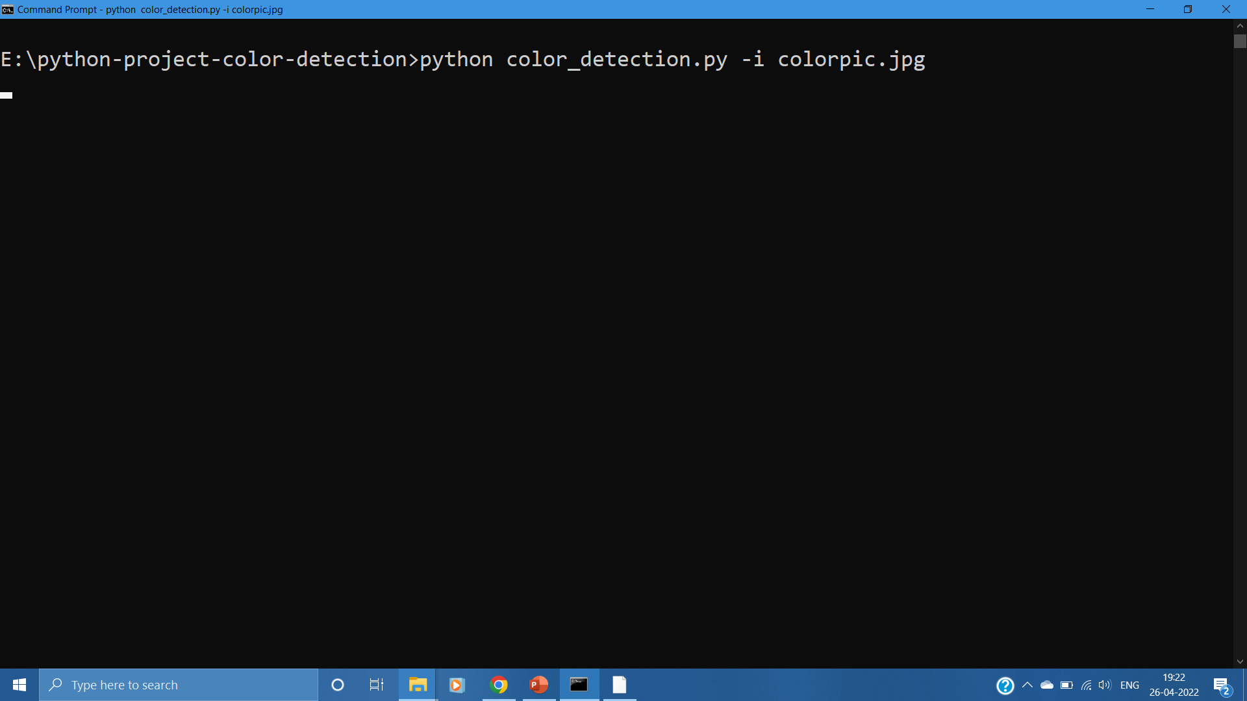

Slide 18
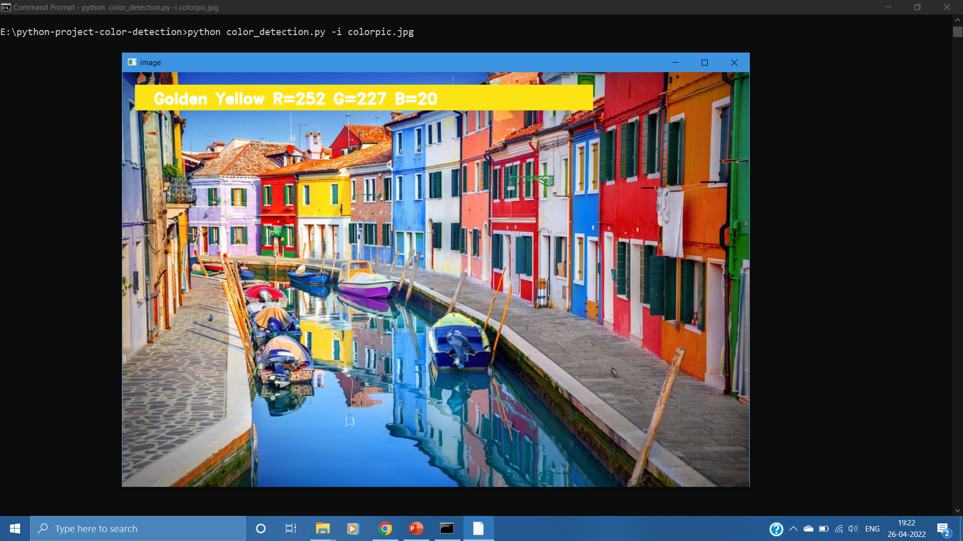
OUTPUT

Slide 19
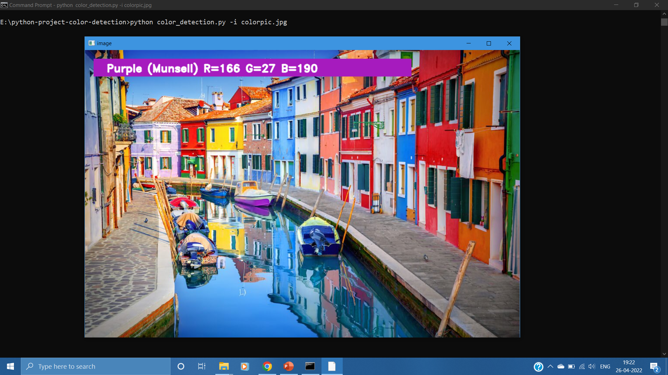

Slide 20
CONCLUSION
In this Python project , we learned about colors and how we can extract color RGB values and the color name of a pixel. We learned how to handle events like double-clicking on the window and saw how to read CSV files with pandas and perform operations on data.
This is used in numerous image editing and drawing apps.

